Slide 1
Flood monitoring & EARLY WARNING
TEAM NAME: TEAM MEMBERS: 1.GNANESWARAN(113321104024)
Proj_224785_Team_3 2 Mohan KUMAR (113321104061)
3.DRAVID(113321104021)
4.HARSHAVARDHANREDDY(113321104029)
5.NAVADEEP(113321104020)
Phase 2: Innovation

Slide 2
Project Objectives :
A flood monitoring system aims to enhance flood preparedness, response, and management by utilizing technology and data analytics. The specific project objectives can vary based on the context, location, and scale of the flood monitoring system. Here are common project objectives for a flood monitoring system:
Early Warning and Alert System:
Develop a timely and accurate early warning system to notify authorities and the public about potential floods in specific areas.
Real-Time Data Collection and Analysis:
Establish a system to collect real-time data on weather conditions, river levels, precipitation, and other relevant parameters to analyze and predict potential flooding events.
Flood Risk Assessment and Mapping:
Conduct flood risk assessments and create detailed flood hazard maps to identify vulnerable areas and help in urban planning, disaster response planning, and infrastructure development.

Slide 3
Community Engagement and Education:
Engage with local communities to educate them about flood risks, preparedness, and response measures to minimize damage and loss of life during flooding events.
Integration of Sensor Technologies:
Implement advanced sensor technologies to monitor water levels, rainfall, and other parameters that are crucial for flood prediction and monitoring.
Data Visualization and Reporting:
Develop a platform that visualizes the collected data in an accessible and understandable manner for decision-makers and the general public.
Improved Communication and Coordination:
Enhance communication and coordination among relevant agencies, organizations, and stakeholders to ensure a rapid and effective response during flood events.
Resilience and Disaster Recovery Planning:
Assist in developing resilience strategies and disaster recovery plans to minimize the impact of floods on affected communities and restore normalcy post-flood.
Capacity Building and Training:
Provide training and capacity-building programs to relevant personnel involved in flood monitoring and response to ensure efficient use of the monitoring system.
Cost-Effectiveness and Scalability:
Strive to optimize the system for cost-effectiveness, scalability, and sustainability to ensure its long-term viability and applicability in various geographical and socio-economic contexts.

Slide 4
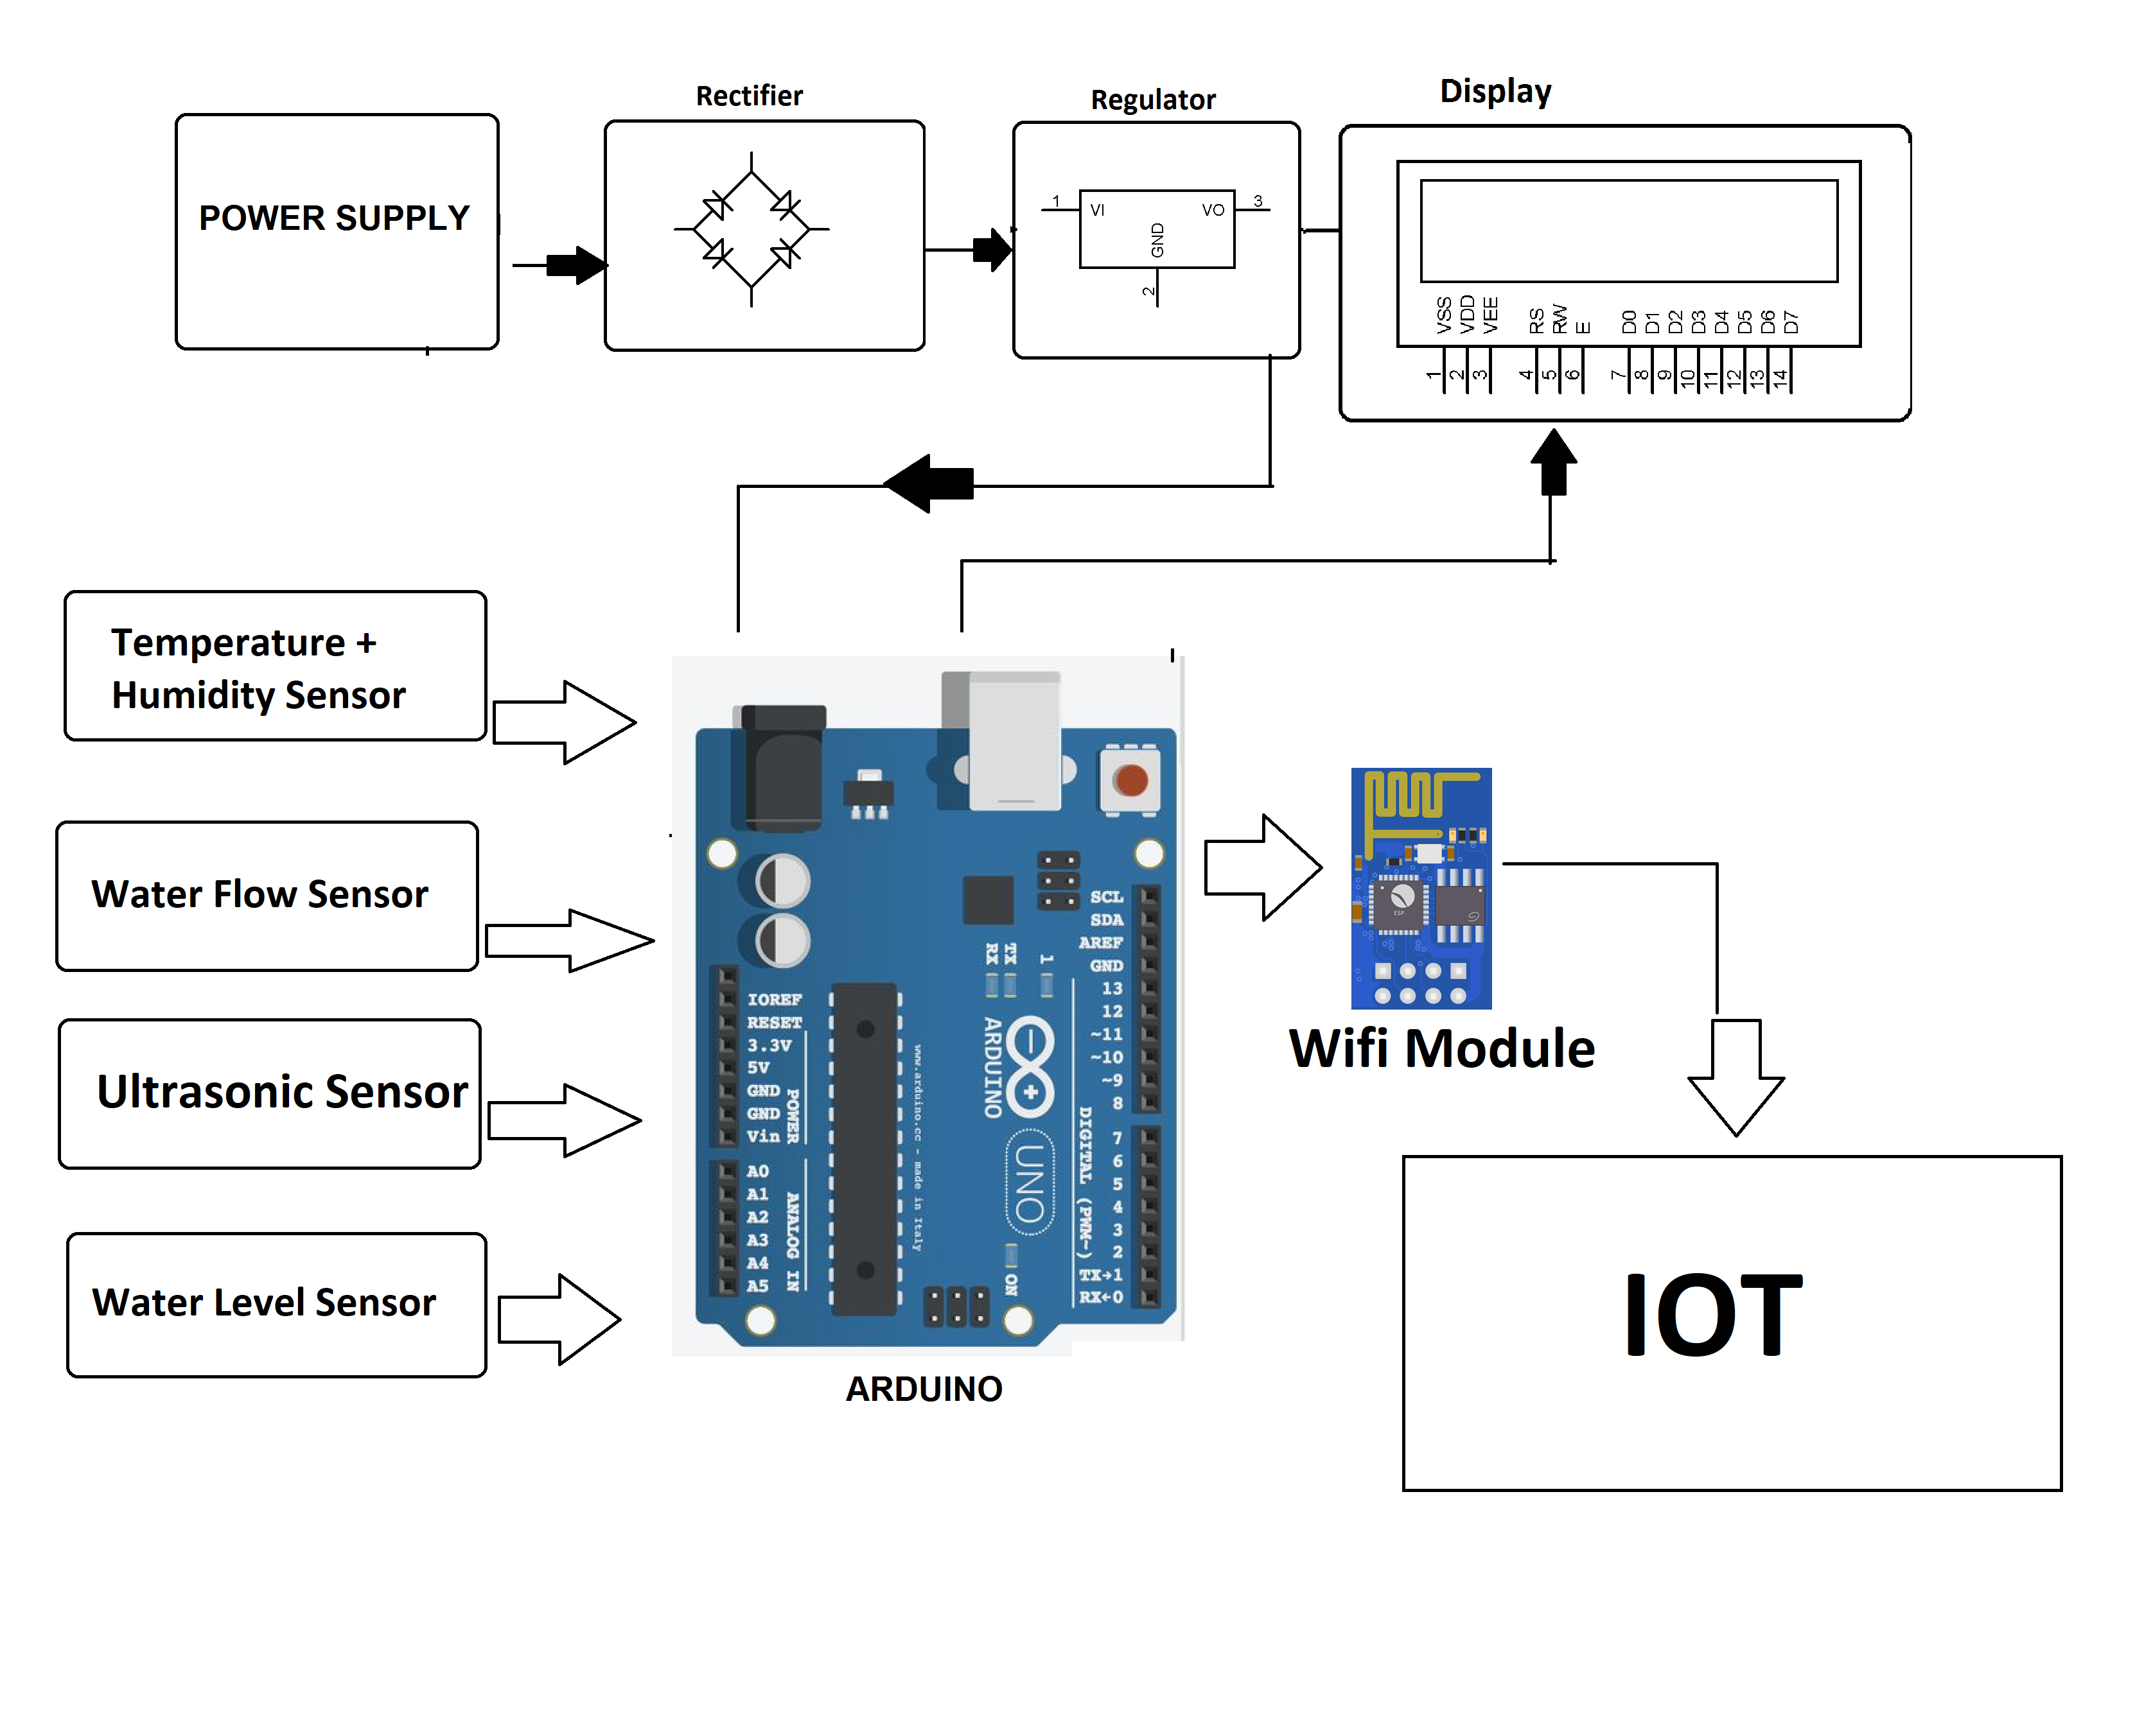
Virtualization diagram on iot

Slide 5
IOT SENSOR
Creating a virtualization diagram for an IoT-based flood monitoring system involves illustrating the various components and their interactions. In an IoT-based flood monitoring system, sensors, data processing, communication, and visualization components play crucial roles. Here's a high-level virtualization diagram for an IoT-based flood monitoring system:
Sensors and Data Collection:
Sensors deployed in flood-prone areas (e.g., riverbanks, urban areas) collect data such as water levels, weather conditions, rainfall, and soil moisture.
Cloud Infrastructure:
The cloud infrastructure comprises servers and databases where the collected and processed data is stored. It may also involve cloud-based data processing and analytics services.

Slide 6
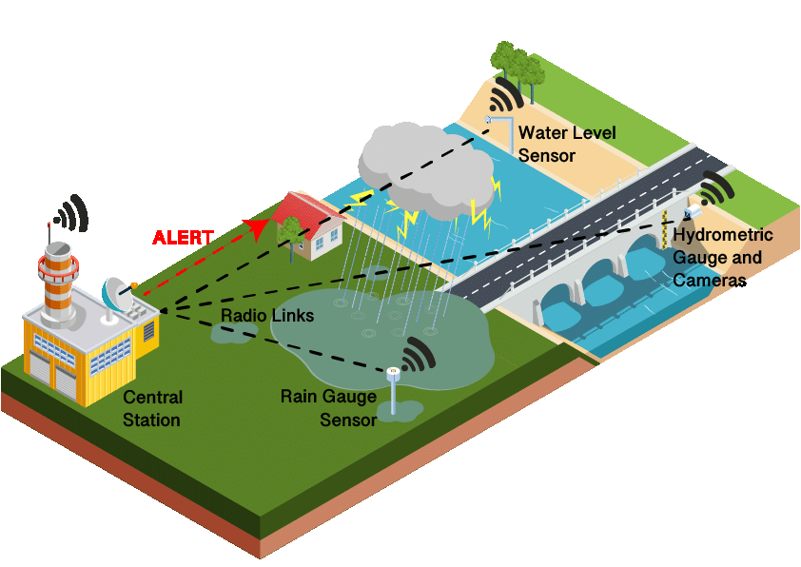
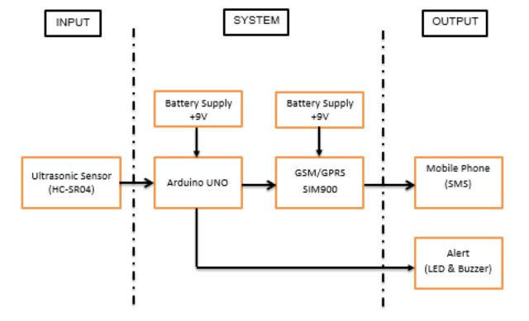
Remote Monitoring and Control:
Sensor settings.
perform maintenance.
troubleshoot issues remotely.
Security Measures:
Implement security measures to protect sensor data.
Prevent tampering.
Use encryption for data transmission and authentication mechanisms for data access.
Real-Time Clock (RTC):
Include an RTC module to timestamp data accurately
Enabling synchronization with other sensors.
Systems.

Slide 7
RASPBERRY PI
INTEGRATION :
Raspberry Pi is a popular single-board computer that is widely used for various projects, including robotics, home automation, and educational purposes. To integrate Raspberry Pi with a smart home system, you can follow these steps:
1.Hardware Setup: Connect the Raspberry Pi to the smart home system by using a suitable communication protocol, such as Wi-Fi or Bluetooth. Additionally, connect any sensors or actuators required for the project.
2.Software Setup: Install the necessary software on the Raspberry Pi, such as an operating system (e.g., Raspbian), programming languages (e.g., Python), and libraries for interfacing with the smart home system.
3.Programming: Write a program on the Raspberry Pi that can communicate with the smart home system. This program should be able to send commands to control the smart home devices and receive updates about the current state of the smart home system.
4.Testing: Test the program by running it on the Raspberry Pi and observing the behavior of the smart home system. Make any necessary adjustments to the program based on the test results.
5.Automation: Set up the Raspberry Pi to automatically run the program at specific intervals or in response to specific events. This can be achieved by using tools like cron jobs on Linux or Task Scheduler on Windows.
6.Security: Implement security measures to protect the Raspberry Pi and the smart home system from unauthorized access and potential threats. This may involve using encryption, secure communication protocols, and strong authentication methods.
By following these steps, you can successfully integrate a Raspberry Pi into a smart home system and create a wide range of automation and control features for your home.</s

Slide 8
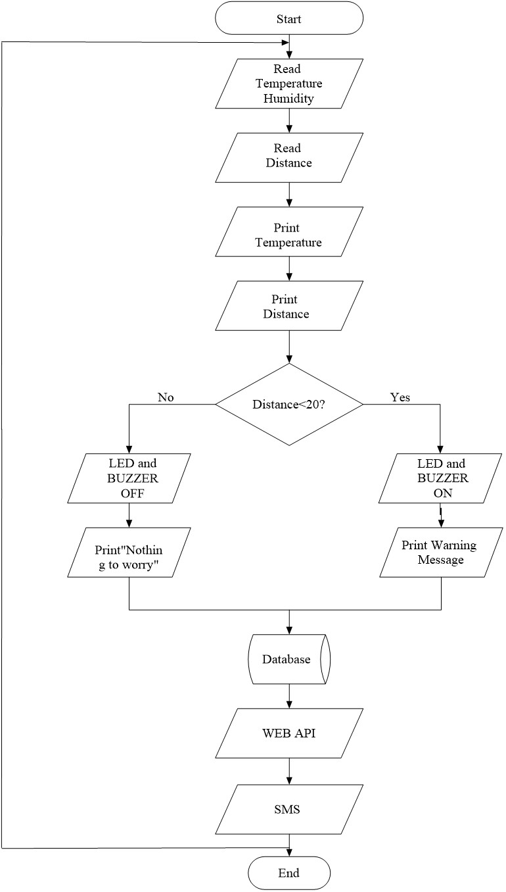

Slide 9
Aspect | Description |
|-------------------------|------------------------------------------|
| Raspberry Pi Model | The specific Raspberry Pi model used. |
| Operating System | The OS installed on the Raspberry Pi. |
| Integration Purpose | The goal or objective of the integration.|
| Connection Interface | The method used to connect peripherals. |
| Power Supply | How the Raspberry Pi is powered. |
| Sensors/Components | List of sensors or components integrated.|
| Communication Protocol | Communication method (e.g., GPIO, I2C). |
| Software/Programming | Programming languages or tools used. |
| Integration Challenges | Any difficulties faced during integration.|
| Testing and Debugging | Procedures for testing and debugging. |
| Power Management | How power consumption is managed. |
| Security Measures | Measures taken to secure the integration.|
| Data Storage | Where and how data is stored (if relevant).|
| Integration Status | Status of the integration (e.g., completed, ongoing).|

Slide 10
CODE IMPLEMENTATION :
Hardware Setup:
Connect the DHT22 sensor to the Raspberry Pi's GPIO pins.
Connect an LED to another GPIO pin.
Ensure your Raspberry Pi is properly powered and connected.
Software Setup:
Make sure you have Python installed on your Raspberry Pi.
Install Required Libraries:
Install the Adafruit_DHT library for reading sensor data

Slide 11
CODING :
import random
import time
import smtplib
from email.mime.text import MIMEText
# Simulated water level data (replace with actual sensor data)
def get_water_level():
return random.uniform(0, 10) # Replace with actual sensor data retrieval
# Set your predefined warning threshold
warning_threshold = 7.0 # Adjust as needed
# Email configuration for sending warnings
smtp_server = 'smtp.example.com'
smtp_port = 587
smtp_username = 'your_username'
smtp_password = 'your_password'
sender_email = 'your_email@example.com'
recipient_email = 'recipient@example.com'
def send_email_alert(message):
try:

Slide 12
server = smtplib.SMTP(smtp_server, smtp_port)
server.starttls()
server.login(smtp_username, smtp_password)
msg = MIMEText(message)
msg['From'] = sender_email
msg['To'] = recipient_email
msg['Subject'] = 'Flood Warning’
server.sendmail(sender_email, recipient_email, msg.as_string())
server.quit()
print("Warning email sent successfully.")
except Exception as e:
print(f"Error sending email: {str(e)}")
while True: water_level = get_water_level() # Check if water level exceeds the warning threshold
if water_level > warning_threshold:
warning_message = f"Flood warning! Water level is {water_level} meters." send_email_alert(warning_message)

Slide 13
CONCLUSION:
1.Risk Reduction: Implementing a flood monitoring and early warning system helps reduce the risk of flood-related disasters. It provides valuable information to authorities and residents, enabling them to take proactive measures to protect lives and property.
2.Lives Saved: By providing timely and accurate flood warnings, these systems can significantly reduce the loss of life during flood events. Evacuations and other safety measures can be initiated in advance.
3.Property Protection: Early warnings allow property owners to take measures to protect their homes and assets. This can include moving valuables to higher ground, installing flood barriers, or evacuating vulnerable areas.
In conclusion, flood monitoring and early warning systems are vital tools for disaster risk reduction and management. Their effectiveness relies on accurate data collection, robust infrastructure, timely communication, and community preparedness. Continued investment in these systems is crucial to protect lives, property, and economies in flood-prone regions around the world.

